Slide 1
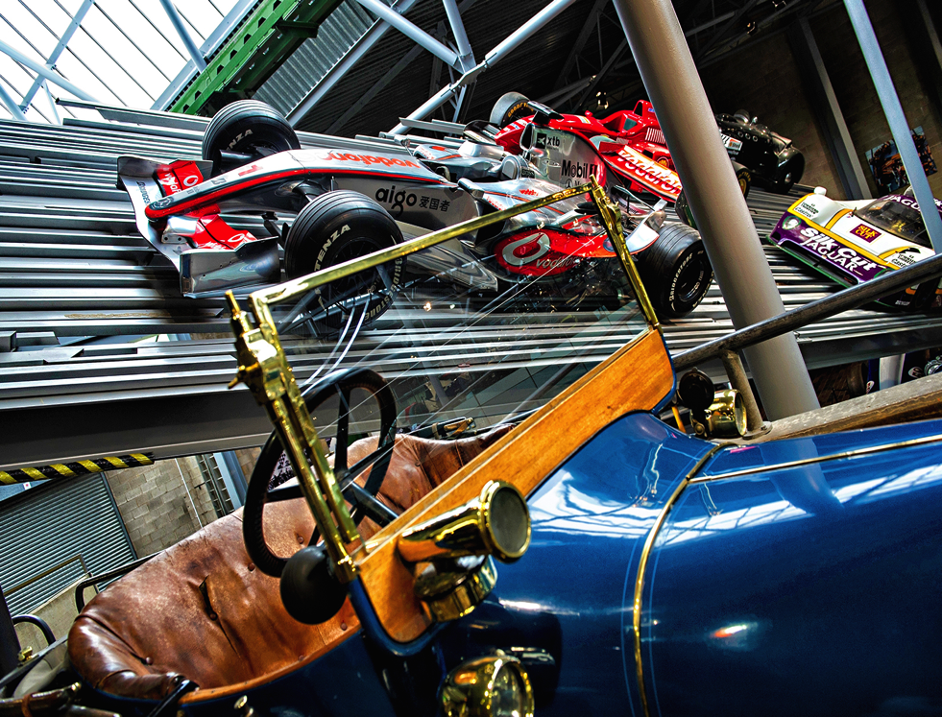
For further
information go to
www.waitmeeting.org
-
Registration fee £45
-
Inclusive of lunch and refreshments
-
Abstract submission deadline extended - 5pm Friday 14th September
-
Following the meeting join us for
the
WAIT SOCIAL
at Monty’s Inn
Beaulieu
home of the national motor museum
17TH OCTOBER 2018
WAIT ANNUAL
SCIENTIFIC MEETING
OUR EXCITING PROGRAMME INCLUDES:
MANCHESTER ARENA BOMBING
NAP 6
SPACE MEDICINE
RESILIENCE and COPING
Being a MOTOR SPORTS medic
Training updates
SPARC update
Email QUERIES & ABSTRACT SUBMISSIONS
for oral and poster presentations (£100 prizes!) to:
waitconference2018@gmail.com
5 CPD points

